Slide 1


 | Author: Jonathan Howell Date: 13/01/2019 Version: 1.01
Corporate Agility & Planning – William Hill Version
Organisation Reference
APM
Harvard Business Review
PMI
PMSolutions
ScrumAlliance
Scrum.Org
Reference Material
AgileInANutshell
Analyzing Process Health
Cone of Uncertainty
How to Stop Overplanning (Even If You’re a Perfectionist)
PMBOK
Planning Extreme Programming
Software Estimation: Demystifying the Black Art
Strategies for Project Recovery
Personal Contributors
James Curtis
Nick Duplessis
Draft Content Reviewers
Ludmila Borylo
Lukasz Krzyzek
Mateusz Pluta
Mateusz Gurgul
Version: 1.01

Slide 2

Plans are worthless, but planning is everything
 | Dwight D. Eisenhower
“When preparing for battle, I
find the plans are useless, but
planning is indispensable”
Version: 1.01
2

Slide 3
3
Dollars at Risk in the average organization: $74 million
Average number of Projects closed per firm | 155
Average total cost of closed Projects per firm | $200 million
Average cost per Project | $1.3 million
Percentage of Projects at Risk | 37%
Average dollars at Risk per firm | $74 million
Average dollars saved due to successful Project recoveries per firm | $50 million
Average dollars lost due to Project failures per firm | $24 million
This data represents 20,821 Projects closed in the last 12 months by 134 organizations Source: PMI

Slide 4
4
The top five causes of troubled Projects
Requirements | Unclear, lack of agreement, lack of priority, contradictory, ambiguous, imprecise
Resources | Lack of resources, resource conflicts, turnover of key resources, poor planning
Schedules | Too tight, unrealistic, overly optimistic
Planning | Based on insufficient data, missing items, insufficient details, poor Estimates
Risks | Unidentified or assumed, not managed
Strategies for Project Recovery Study Source: www.PMSolutions.com

Slide 5
5
The problem with Planning
Ideation is a flux state - no granularity or even scope
The least is known but we try to commit to dates (usually with a cost implication)
Dates promised without understanding the code or the skillsets (required or available)
Teams not established but we commit without knowing lead times, true Complexity (or even day rates)
Precision / Detail Metrics (time and size) are too low level for Block Planning
Time wasted estimating in hours that will be changed by individual Teams and skills
We don’t know what we don’t know! Donald Rumsfeld

Slide 6

A scientific approach to Delivery
Marketing Promises
Sales Optimise Profit
Development told…
“Just do it”
Unsustainable Model
Overtime → Stress → Low Morale = High Turnover + Knowledge Drain & Instability

Slide 7
7
Comfort Blanket Syndrome
Most organisations navigate projects with layers of hierarchical communications. This is usually centred around Comprehensive Plans and gives an illusion of control and precisions. Typically each layer focuses on progress metrics against the next level granularity. Emphasis on this approach is typically driven by the following factors:
Comfort | There is a preference to have a solid date even if it’s not real. It is better to have a superficial date rather than accepting that we don’t know.
Motivation | Having a solid date “gives teams something to aim for”
Accountability | Traditional leadership models use seniority to leverage teams into delivery
Fear of Change | Changing the way a company considers ‘deadlines’ can result in a significant change in the way the business and the delivery teams interact.
Slide content courtesy of James Curtis
Life is 10% what happens to you and 90% how you react to it. Charles R Swindoll

Slide 8
The problem with Forecasting (Time Estimate)
Business driven (deadlines, milestones etc)
Fixed scope, time and budget
Wrong people do the Forecast
Forecasting takes too long and is wrong anyway
Team not created that work with the Forecast
Ambiguous / changing requirements are hard to Forecast
Difficult to predict what will be delivered and when
High Level Plans and Forecasts are not Project Plans – Forecasts & Estimates are not fixed commitments
Even meteorologists only Forecast for the short term!

Slide 9
9
Agile Estimation
The primary purpose of software estimation is not to predict a Project’s outcome; it is to determine whether a Project’s targets are realistic enough to allow the Project to be controlled to meet them.
If we can identify the Features we want to deliver Estimate the size of these Features in a relative manner Then we can priorities their importance. With relative sizes and priority, we have the formation of a Roadmap. By adding dependancies we have an approach to delivery.
 | We still don’t know how long this is actually going to take but we can now apply our best guess by applying empirical data to quantify and qualify this. – OUR ESTIMATE!
Software Estimation: Demystifying the Black Art Steve McConnell
I need this much,
when will I get it?
Scope
Time
I need it by this
date, what will I get?
Scope
Time
"Empirical" means "based on observation or experience" Source: https://www.merriam-webster.com

Slide 10
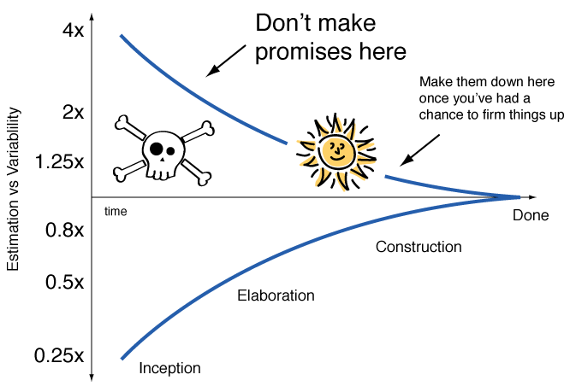
The Cone of Uncertainty
Cone of Uncertainty Steve McConnell
Estimation & Understanding
Estimates up front can be +/- 400% in inception
At elaboration it’s still +/- 300%
At release planning this can be down to +/-200%
Only during the construction are things realistic
The further we look into the future, the less we can predict with any degree of certainty.

Slide 11
The further we look into the future, the less we can predict with any degree of certainty…
Product Backlog
Iteration Backlog
Levels of Detail
As the level of understanding increases, so the level of confidence can be improved.
If you don’t tell me what you want, I cannot tell you how I can do it, or by when!
NOW
Forecast
Aspirational
Next
Time Travel Consideration
What will we discuss as the next agenda item?
What will you be doing tomorrow?
What are you doing next Monday?
Now what about the last Monday of November?
Next + 1
Unpredictable
In a world of uncertainty – can Agile help?

Slide 12

Value Driven & Adaptive
Predictive
Model
Adaptive
Model
Constraints
Requirements
Schedule
Budget
Plan Driven
Value Driven
Estimates
Schedule
Costs
Features
Your plan for the day, the week, or even the year, is a Roadmap that gives
you a sense of direction and a high-level overview of the various paths you could take.
How to Stop Overplanning (Even If You’re a Perfectionist) Source: Elizabeth Grace Saunders / Harvard Business Review
12

Slide 13
Agile is Value Driven and Adaptive
Agile
As the level of understanding increases, so the level of confidence improves.
Permanent Teams means lead time are reduced
Work commences immediately (no laggards on design or Assumption ratification)
Value is released frequently & in order of Feature Priority or ROI
Assumptions and changes in direction are dynamically accommodated
Planning is continuous and progress is transparent
Run costs are static & easily obtained
Traditional
High Risk as the process is set up once (up front) and assumes a lot
A Project Team first has to be formed before work starts
Comprehensive solutions required before development work commences
Value (or success) only occurs periodically – in some cases only at the end
When the Value diminishes we stop!

Slide 14
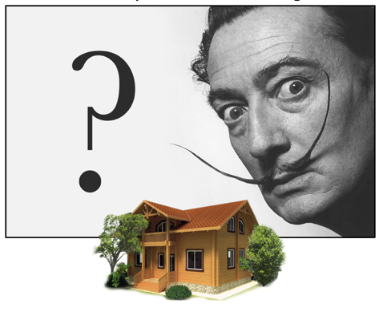
Estimating is tricky…
How long would it take to build a house? ….6 months? 1 year, 2 years?
Many criteria can influence the estimation process:
Where is the house located?
How big / Complex is the house?
How many rooms will it have?
What type of material will be used?
How many people will work on it?
Is it connected to the main supplies?
“How did your last estimation go?”
Slide content courtesy of Nick Duplessis
So what is the answer?

Slide 15

This (Feature) looks to be twice as big as that one…
Humans are really good at sizing things relatively. We can’t tell you precisely how big a rock is.
But we can tell you how big it is compared to something else. We can use this when sizing Projects too.
Software Estimation: Demystifying the Black Art Steve McConnell
We don’t know what we don’t know! Donald Rumsfeld

Slide 16
Empirical Modelling
If we have an understanding of the size and Complexity of the Features (Estimate)
If we understand the dependancies and priority (Roadmap)
If we know the (average) amount of work a Team can process (thoughput)
If we know the [run/loaded/fully loaded] costs for a Team
Then we can apply meaningful business logic to to generate a Value Driven Estimate
REMEMBER:
  Estimate don’t plan (we still don’t know what we don’t know)
  Features are generally fixed but the detail can / will change over time
  Estimate Feature sizes then use Velocity / Throughput to understand the potential duration
  Use Risk Metrics to weight the initial outcomes to provide ranges (3 Point Planning)
  Frequently use empirical data to extrapolate and revise Estimates and Assumptions
Run Cost of the Team + Loading Cost = Project Cost for Capitalisation

Slide 17
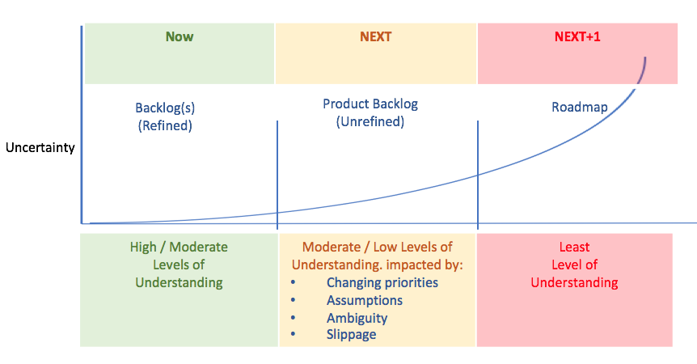
Planning is Continuous and Progress is Transparent
Inspection & Adaption
We don’t know what we don’t know The further in the time horizon, the greater the ambiguity We work in a learning environment. We encouraging inspection and adaption
An Agile Team with a health backlog should know their target candidates for the next few Iterations with INCREASING levels of granularity. The CLOSER to the current Iteration, the GREATER the understanding.
From 2 to 4 Iterations is the ASPIRATIONAL window. This is based upon what Teams think they know.
And finally at 5+ Iterations it is THEORETICAL at best!
Assumptions and changes in direction are dynamically accommodated

Slide 18
What are you trying to achieve?
“When preparing for battle, I find the plans are useless, but Planning is indispensable”
“The primary purpose of software estimation is not to predict a Project’s outcome; it is to determine whether a Project’s targets are realistic enough to allow the Project to be controlled to meet them.”
Use the right approach & granularity for estimating:
Strategy Portfolio Product Release Planning Iteration Planning Daily Planning | What are we trying to do Find a Team with the skills to deliver What Feature / themes What sequence do we follow Iteration & Release Goals Iteration activities | Is it $1m or $10m Demand planning (skills / capability map) High Level Roadmap Initiative Roadmap Iteration Roadmap Iteration Activities
Software Estimation: Demystifying the Black Art. Steve McConnell
The right tool, for the right job, at the right time, by the right people

Slide 19


Right approach and granularity
Relative Estimation
Affinity Planning Relativity Planning
Block Planning User Story Mapping Iteration Roadmaps High Level Tshirt Sizing Calibration Scaling
Absolute Estimation
Iteration Planning Story Poker
Iteration Goal Team Level Tshirt Sizing Team Level Poker Planning Task Level Planning
The further we look into the future, the less we can predict with any degree of certainty

Slide 20
Sizing Metrics
Sizing Techniques for Relative Estimations
Affinity Planning
1. Divide the Tasks between everyone in the group
2. Draw a line on a wall. Indicate Smallest on the left and Largest on the right
3. In silence each person adds their Tasks to the wall, in increasing order of Feature Size
4. When all Tasks are on the wall they are collectively reviewed (sweeping from smallest to the largest) Tasks should be size shifted left or right as appropriate This sweeping exercise is repeated until, until all Tasks are agreed upon by the collective
5. Agree some vertical segregation groupings for Tasks on the wall – this defines the Deliver Unit Sizes
Relativity Planning – Similar to Affinity but assumes some basic domain knowledge
1. Place all Tasks on a table
2. Place some KNOWN ‘anchor Tasks’ at relative spacing
3. Discuss the each Task in turn and then place them relative to the existing anchored Tasks
If an agreement cannot be reached then a Risk is recorded against the Task

Slide 21
PMO/ PMI Metrics
Risk Weighting Techniques for Relative Estimations
Various techniques for Risk Weighting during planning are listed below:
Consider using Complexity Bucket Weighting (next page)
For Affinity Planning – when executing the sweep: place a dot on each Task before moving every move gets a dot – so if it is moved twice it gets 2 dots
For any Task that is discussed – add a dot (even if there is no change in outcome)
For disputed Tasks, for each viewpoint, add up to 3 dots to the Task to record individual(s) concerns
For each Risk, Assumption, Dependency or unknown add up to 3 dots to the Task to record the ambiguity (either collectively or as individuals)
Aggregate Weighting considerations
When using multiple techniques (from above) – ensure the dots carry a common definition for Weighting
Do not lose any sizing or positional data. As understanding grows these Weightings may need revising!
You may want to resize Tasks based upon the final Risk Weighting

Slide 22
Complexity Bucket Weighting
This technique works with technical teams, or well established Teams with domain knowledge
Predefine some Consideration Buckets (usual max of 5), based upon the requirements Typical Consideration Buckets may include: Interface, Logic, Data, Integration, Testing, Rollout etc.
If appropriate collectively define some scoring notes (e.g. 3rd party interface = +4, new interface= +3, existing interface = +1)
Review each Task in turn to gain a common understanding
Against each Consideration Bucket collectively discuss & score the Task between (0 - N/A & 5 – max Risk)
Total the Consideration Bucket score for the Task to get its Complexity Weighting
Lay the Tasks out in a incremental sizing order to be able to group the Tasks by Weighting
Optionally, map the grouped Tasks to your predetermined Risk Valuation Matrix or Delivery Unit sizes
Whilst this is a Risk Weighting Technique, it works equally well for estimations

Slide 23
Delivery Rates
Delivery Rates: Monitoring progress towards a given Goal
There are two common forms of this Agile Metric:
Throughput | The rate at which a Team can release work items which release Business Value
Velocity | The amount of work (Delivery Units) that a Team can release in an Iteration
Both are about the average numbers that a Team is capable of delivering within a finite timeframe. Both assume a uniform work load.
Logically, the objective is to continuously improve it.
But there are multiple factors that can influence it: Bad Requirements (e.g. User Stories with a poor Definition of Done criteria) Technical Debts (e.g. unexpected necessary refactoring) Process bottlenecks (e.g., QA overloaded, troublesome deployment pipeline) Backlog with a low level of items ready for development Scope change (e.g. changing the scope of a Feature in the middle of an Iteration)
Uncertainty is one of the few certainties about software development
Analyzing Process health Source: Raphael Albino

Slide 24
Velocity, Capacity and Extrapolation
Velocity
Velocity is the amount of work (Delivery Units) that a Team can release in an Iteration
Velocity is calculated at the end of the Iteration for fully completed features only
Velocity is variable (often cyclic in nature)
Velocity is a laggard metric
Velocity can be impacted by may internal and external factors:
Internal | External
Number of Team members (ideally 7 +/-2) Skills & Domain knowledge Maturity of Team Team Dynamics Team changes Resource* Availability / Capacity | Environment Availability & Stability Priority Changes Acceptance Criteria Interrupts Time of year Multi Tasking Quality and age of codebase
It’s not about Agile – it’s about agility!

Slide 25
Velocity, Capacity and Extrapolation
Delivery Rates are consistently unique to each Team
Delivery Units: The Delivery Unit is ALWAYS a Team Metric and is not transferable nor comparable with other similar Teams.
Velocity = Delivery Unit per Iteration: The type of Delivery Unit can vary from Team to Team. It may be Time, Cost, Story Point, Complexity, Tshirt Sizes or any other measurement – there are even animal sizes in exitance!!!
Calibrating Scaling: Enterprise or Scaled Agility An international company may trade in many currencies worldwide. The currencies can free float against each other, but when reporting financials there is always a base currency to map to. Calibration Scaling works in a similar way – the Agile Teams keep their unique unit of delivery, but map to a calibrated scale for reporting progress – as their definition of a unit of delivery matures, so their reporting can be recalibrated if needed. This approach provides a consistent method of tracking progress across multiple Teams.
Burn Up Charts: Provide Projected Dates, they are not Project Plans, but they can support financials Completion Date = Remaining work / (Rolling Velocity * Predictability) + Buffer
Using a technique called Yesterdays Weather, Velocity can be used as a Trend & Forecast Indicator
Yesterday’s Weather Source: Planning Extreme Programming

Slide 26
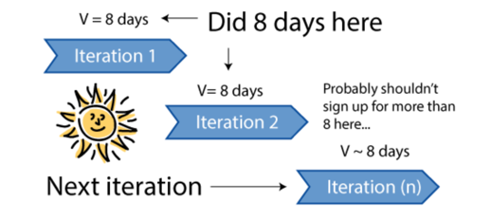
Velocity, Capacity and Extrapolation
Yesterday’s Weather
Based upon observation or experience, we can gain meaningful insights with minimal revenue outlays.
As this is a variable (often cyclical) laggard metric, we can smooth this Indicator using a rolling averages.
With consideration of Capacity as an overlay, we can use all of this to obtain meaningful metrics…
The Story
A government once spent a small fortune developing and deploying a weather satellite system to provide a 70% accurate Forecast.
Today’s weather is 70% likely to be the same as yesterday’s!
Based upon the Yesterday’s Weather Technique, Velocity can be used as a Trend Indicator

Slide 27
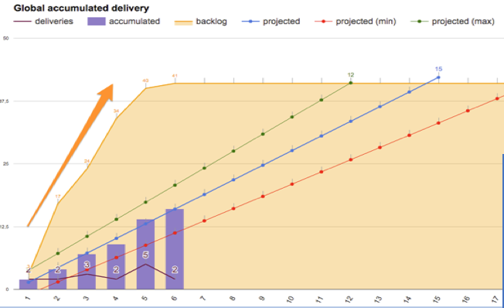
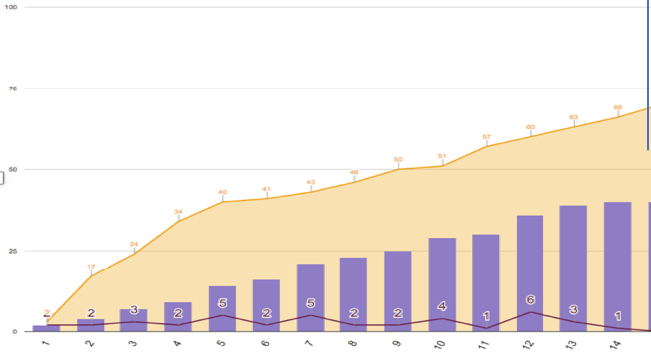
Delivery Rates
Given: the relative sizing of the work the delivery rates of the Team And factoring in Risk Weighting & Complexity Using 3 Point Planning, we can now extrapolate time (and cost) thereby generating a Value Driven Estimate
Over time: Features are refined, granularity introduced, and meaningful progress against Value is unveiled Assumptions on delivery rate are replace with factual (Empirical data) providing true run costs Change to scope or direction are better understood, facilitated and adopted
When the Value diminishes we stop!

Slide 28
Velocity, Capacity and Extrapolation
Capacity
There are many factors that can impact a Teams capability to deliver. This is often visible in the Delivery Metrics. Capacity Constraints should be factored into any Velocity considerations.
Examples include:
Personal | Internal | External
Public Holiday
I have a holiday booked | New to Team | Dependency on third party
I am not well | Changing Team | Department priorities
Training courses | No domain knowledge | Environment constraint
Worked very late last night | New technology requirement(s) | Resource conflicts
A Team should never be Fully Loaded – not all Capacity Constraints are predictable!

Slide 29
Velocity, Capacity and Extrapolation
Extrapolation: Trend Indicators
Rolling Velocity - the average rate of progress Velocity is often cyclical in nature. (Lower, then higher, then lower again) This typically occurs when a Feature is not fully completed within the Iteration (called Carry Over) Average Rolling Velocity can be used to provide a meaningful metric (the average of 3 Iterations or more)
3 Point Planning – the high, the low and the probable 3 Point Planning is not unique to Agile, there are various methods that can be applied to the Velocity, or the rolling Velocity to obtain this indicator: Using the Teams fastest, slowest and average (average being mean or mode) Velocity Using Standard Deviations techniques Using Risk Weighting +/- apply to the average Use of Trend Indicator Metrics – Modelling (part of a much more complex approach)
Predictability – more of an accuracy metric As a percentage factor of what the Team set out to achieve how much did they actually achieve Using a rolling percentages, Forecasts can be meaningfully adjusted
Surplus Capacity could be used for Technical Debt, Refinement, or even Stretch Goals!

Slide 30
Velocity, Capacity and Extrapolation
Extrapolation: Forecast Loading
Factoring | Reducing a Teams Capacity by an fixed percentage to accommodate unknowns constraints / requirements. Factoring should also take into consideration any know constraints. The final Value being the sum of the two.
Buffering | Akin to Contingency Planning. It can be achieved by adding finite time to the delivery dates, or by scaling the highs / lows on a 3 Point Plan. May be used in conjunction with Risk Weighting or Complexity Bucket Weighting
REMEMBER:
  Frequently review your empirical data
  The closer to the delivery date the lower the Risk and the extrapolation
  2 people can dig a hole in 2 days – how long to dig half a hole?
Empirical data analysis is still just an Estimate!

Slide 31
Financial Considerations
Agile Financials
It is a myth that finance is difficult or impossible in Agile
As the Team already exists, the costs remain static or persistent. Loaded, Fully Loaded and Unloaded costs are therefore readily available:
Daily Cost | The sum of the Day Rates of each Team member
Run Cost | Daily Cost * Duration of Iteration
Fully Loaded Cost | Run Cost + Overheads (support, management, CapitalEx)
Contingency | This is predominantly a redundant factoring
Feature Driven Model |  | Cost Driven Model
Calculation | Time * Run costs | Fully loaded cost | Calculation: | Budget / Run Cost
Cost Varies |  | Feature Varies
Financial Burn Rates are flat (stable and static) within a true Agile Model

Slide 32
Zombie Scrum and Doing Agile
It is possible to fill all the roles, follow the Ceremonies and generate all the Artefacts of Scrum but still not receive the benefits of Agile.
Using Scrum or any other Agile framework like a rule book is not being Agile. We call this Doing Agile! True agility is about trust, empowerment, creativity, flexibility and innovation.
Accountability & Value can only occur when a Cross Functional Team fully understands and enacts these concepts. A team will never be high performing by simply follow the rules… that is Zombie Scrum!
Even if a team has reached the high performance nirvana this in isolation will not release the Business or Organisational Benefits in isolation. To release true Value the hard work starts within the Business and it’s stakeholders… throughout this deck there are references to Incremental Delivery and Value driven Features; for Incremental Delivery to work, Features must be small enough for the team to deliver them within an Iteration and they must add Value. That is the challenge to the Business and in particular the Product Owner.
If we build a single Feature rich deliverable, using Iterative Development, but it cannot be release until the end, then we are not realising the Value of Incremental Delivery. We are Just Doing Agile and perhaps just Zombie Scrum.
The hardest challenge lies with creating small but valuable increments – that’s the Business Challenge!
The rate of release of Business Value is often referred to as the Throughput.

Slide 33

Example of Iterative Development and Incremental Delivery of Business Value
As a CUSTOMER I would like TO ACCEPT AN OFFER so that I can GET MY LIMITED TIME EVENT
In this simple example a customer obtains an event on a set date – no further context or detail supplied.
Iteration 1 | All the logic of the offer is created and a simple hyperlink – ACCEPT OFFER is supplied
Iteration 2 | When the hyperlink is clicked a new hyperlink box refreshes showing DAYS TO EVENT
Iteration 3 |  | Iteration 4
The link & countdown is replaced with simple static button in the same colour as the rest of the screen |  | In the final iteration, the graphics are introduced and a real time countdown timer Feature is added
ACCEPT
OFFER
NN
DAYS TO
EVENT
Initially not Feature Rich, but incrementally improving - when the Value diminishes we stop!

